Slide 1

Personal expense tracker
Subtitle: SQL Project Presentation

Slide 2

Abstract
The Personal Expense Tracker is designed to help users monitor their financial activity.
Key features include tracking income, expenses, and budgets.
SQL queries (subqueries, joins, and views) power the database analytics.
Notes:
Notes to presenter:
What is your purpose for sharing this reflection?
Is it at the end of a unit or project?
Are you sharing this reflection, at the attainment of a learning goal you set for yourself?
Is it at the end of a course?
State your purpose for the reflection or even the purpose of the learning experience or learning goal. Be clear and be specific in stating your purpose.

Slide 3
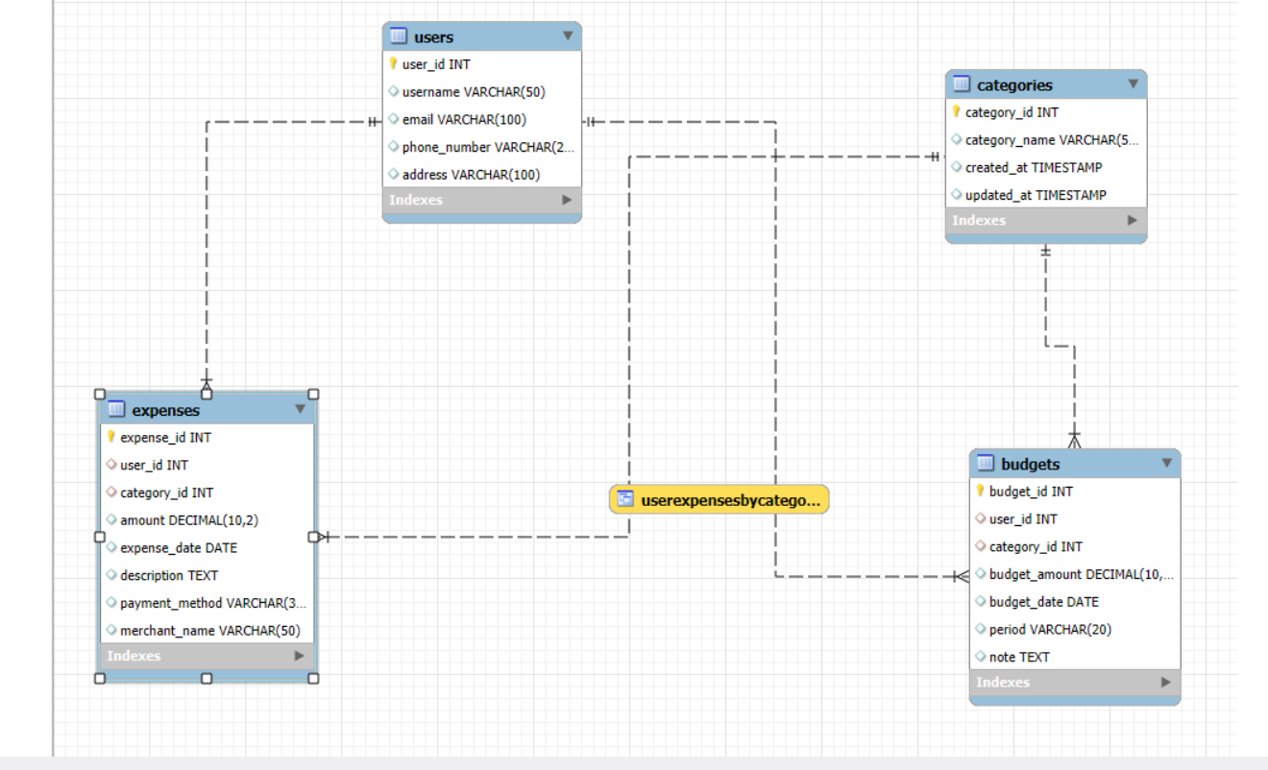

What did you learn?
Notes:
Notes to presenter:
Description of what you learned in your own words on one side.
Include information about the topic
Details about the topic will also be helpful here.
Tell the story of your learning experience. Just like a story there should always be a beginning, middle and an end.
On the other side, you can add a graphic that provides evidence of what you learned.
Feel free to use more than one slide to reflect upon your process. It also helps to add some video of your process.

Slide 4

STRUCTURE OF TABLE
Users Table;
Categories Table;
Budgets Table;
Expenses Table;

Slide 5
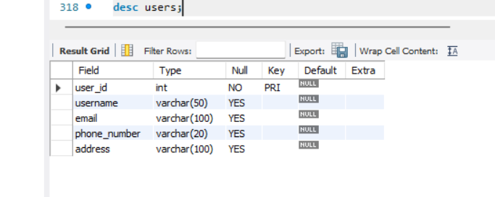
Users Table;
This table Store’s users' personal information
Syntax:desc users;

Slide 6
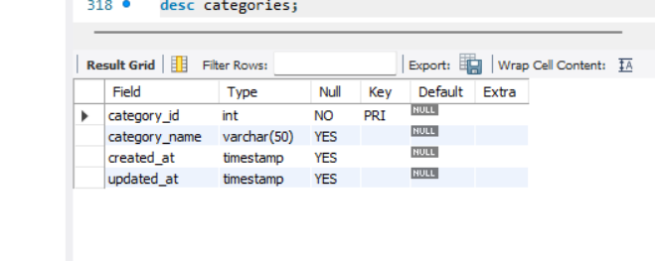
Categories Table;
This table store’s different types of expenses categories
syntax: desc categories;

Slide 7
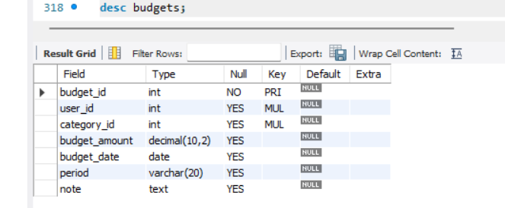
Budgets Table;
This table Store’s users' budgets.
Syntax: desc budgets;

Slide 8
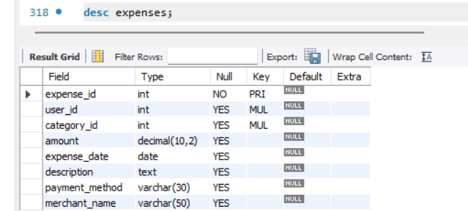
Expenses Table;
This table Store’s users' individual expenses.
Syntax: desc expenses;

Slide 9

CONTENTS OF TABLE
Select* from users;
Select* from Categories;
Select* from Budgets;
Select* from Expenses;

Slide 10
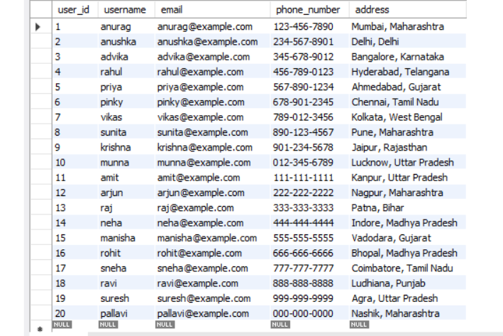
Select* from users;

Slide 11
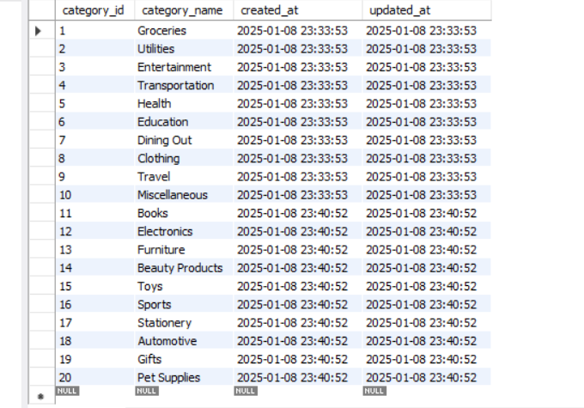
Select* from Categories;

Slide 12
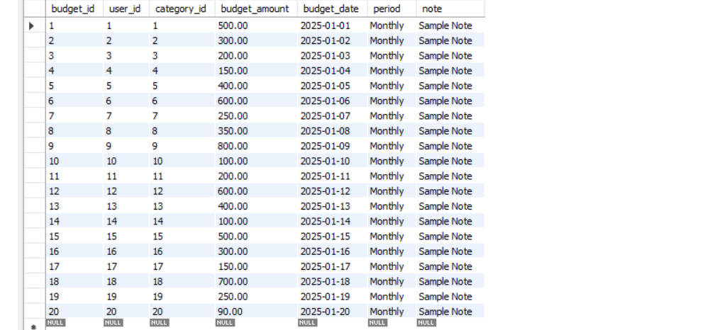
Select* from Budgets;

Slide 13
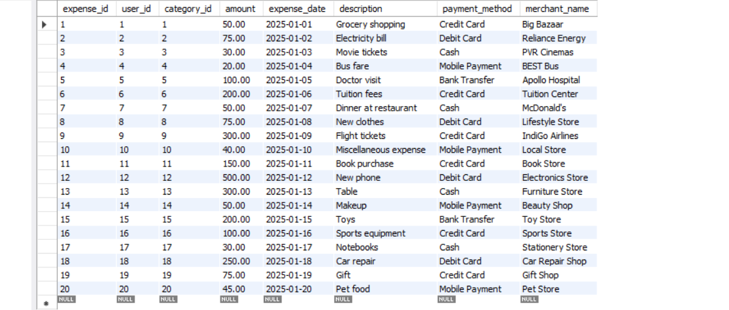
Select* from Expenses;

Slide 14

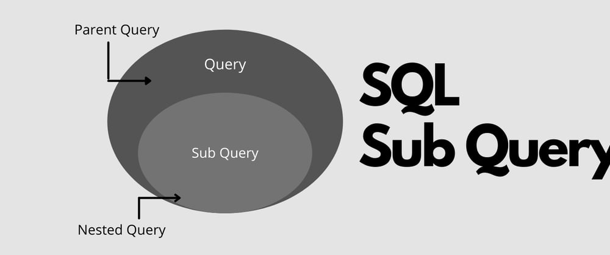
SUB QUERIES
Show users budgets greater >300
more than avg amount spend
Show Remaining Budget for each user in each category
What is the most frequently used payment method
Notes:
Notes to presenter:
What steps will you be taking as a result of this learning experience?
Did you learn from any failed experiences? How will you do things differently?
What advice will you give to others so they can learn from your experiences?
How can you share what you learned with a real-world audience?
Some examples of next steps might be:
After delivering my first persuasive presentation, I am thinking about joining the debate team.
After making my first film, I’m considering entering it in our school film festival or local film festival.
After connecting with this career expert, I’d like to do some research on that career field because it sounds interesting to me.
This SmartArt allows you add images and text to help outline your process. If a picture is worth a thousand words, then pictures and words should help you communicate this reflection on learning perfectly! You can always click on Insert>SmartArt to change this graphic or select the graphic and click on the Design contextual menu to change the colors.
Feel free to use more than one slide to share your next steps. It also helps to add some video content to explain your message.

Slide 15
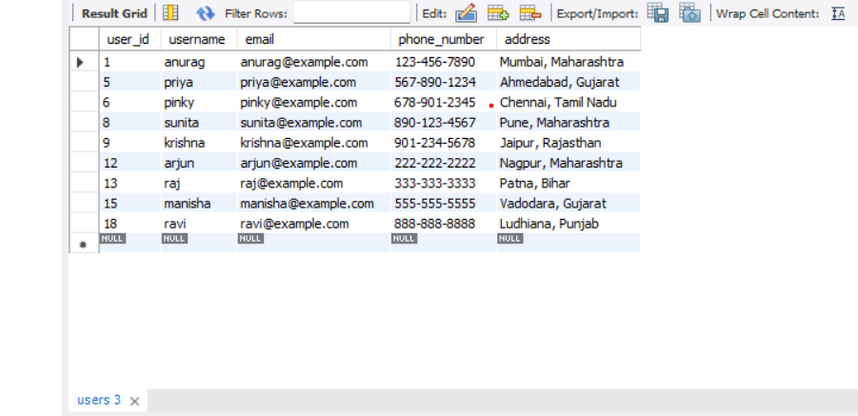
Show users budgets greater >300
SYNTAX:
select * from users where user_id in(select user_id from budgets where budget_amount>300);

Slide 16
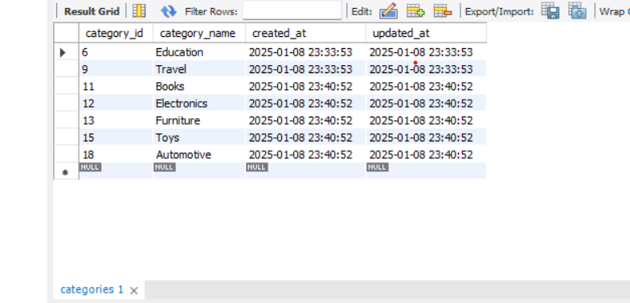
more than avg amount spend
SYNTAX:
select * from categories where category_id in(select category_id from expenses where amount >(select avg(amount) from expenses));

Slide 17
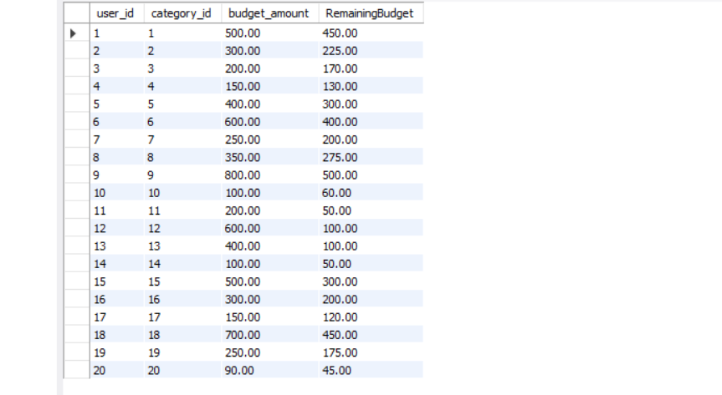
Show Remaining Budget for each user in each category
SYNTAX:
SELECT Budgets.user_id,
Budgets.category_id,
Budgets.budget_amount,
(Budgets.budget_amount - COALESCE((SELECT SUM(amount)
FROM Expenses
WHERE Expenses.user_id = Budgets.user_id AND Expenses.category_id = Budgets.category_id), 0)) AS RemainingBudget
FROM Budgets;

Slide 18
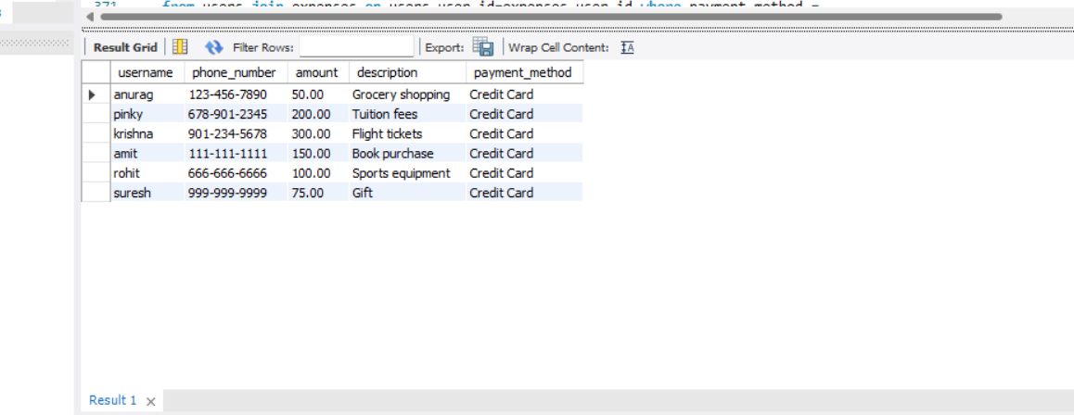
What is the most frequently used payment method
SYNTAX:
select users.username, users.phone_number,expenses.amount,
expenses.description,expenses.
payment_method
from users join expenses on users.user_id=expenses.user_id where payment_method =
(select payment_method from expenses group by payment_method order by count(payment_method) desc limit 1);

Slide 19
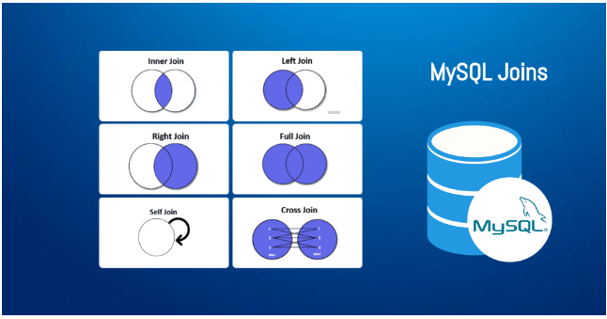
Joins
How can we track Users spending patterns over time
Retrieve user details and their categorized expenses
How can we analyze Users budgets based on their location?
How can we analyze Users expenses in relation to their budget period?
Show users details of monthly budget and expenses
Write a query to find users with the highest and lowest total expenses
Notes:
Notes to presenter:
What steps will you be taking as a result of this learning experience?
Did you learn from any failed experiences? How will you do things differently?
What advice will you give to others so they can learn from your experiences?
How can you share what you learned with a real-world audience?
Some examples of next steps might be:
After delivering my first persuasive presentation, I am thinking about joining the debate team.
After making my first film, I’m considering entering it in our school film festival or local film festival.
After connecting with this career expert, I’d like to do some research on that career field because it sounds interesting to me.
This SmartArt allows you add images and text to help outline your process. If a picture is worth a thousand words, then pictures and words should help you communicate this reflection on learning perfectly! You can always click on Insert>SmartArt to change this graphic or select the graphic and click on the Design contextual menu to change the colors.
Feel free to use more than one slide to share your next steps. It also helps to add some video content to explain your message.

Slide 20
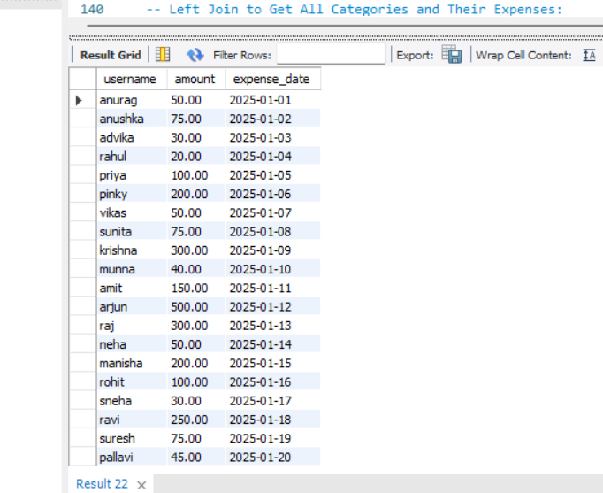
How can we track Users spending patterns over time
SYNTAX:
SELECT Users.username, Expenses.amount, Expenses.expense_date FROM Users INNER JOIN Expenses ON Users.user_id = Expenses.user_id;

Slide 21
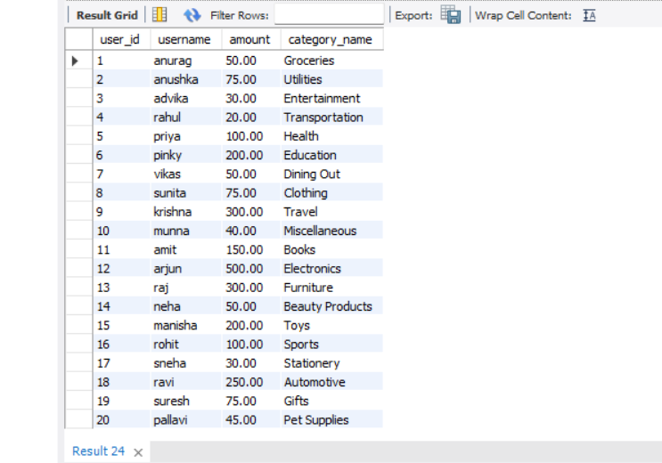
Retrieve user details and their categorized expenses
Syntax:
select users.user_id, users.username, expenses.amount,
categories.category_name from users join expenses on users.user_id=expenses.user_id join categories on expenses.category_id=
categories.category_id;

Slide 22
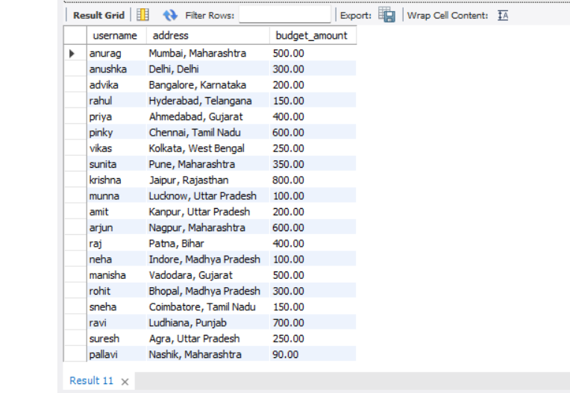
How can we analyze Users budgets based on their location?
SYNTAX:
SELECT u.username, u.address, b.budget_amount FROM users u JOIN budgets b ON u.user_id = b.user_id;

Slide 23
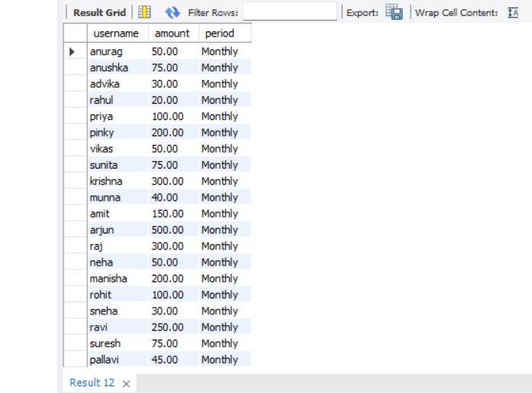
How can we analyze user expenses in relation to their budget period?
SYNTAX:
SELECT u.username, e.amount, b.period FROM users u JOIN expenses e ON u.user_id = e.user_id JOIN budgets b ON u.user_id = b.user_id;

Slide 24
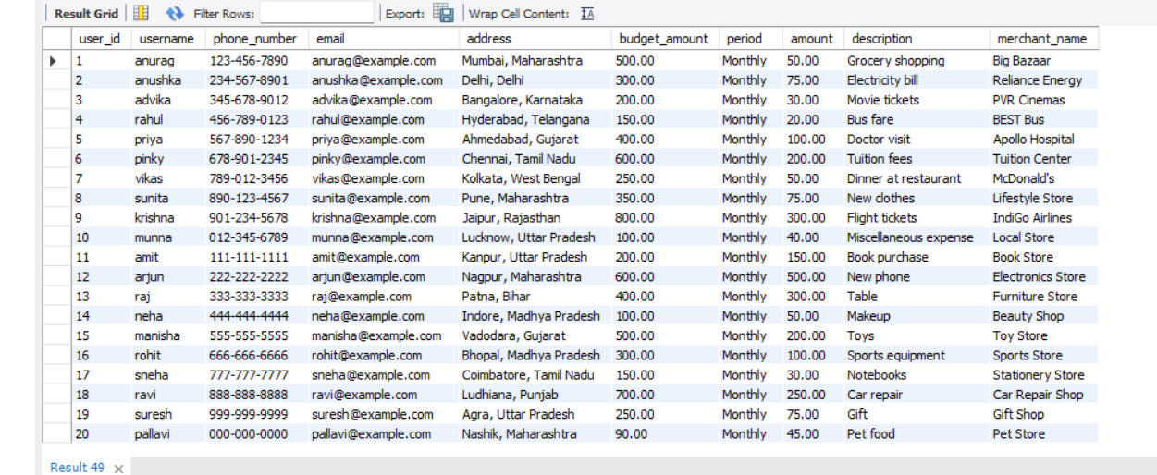
Show users details of monthly budget and expenses
SYNTAX:
SELECT users.user_id,users.username, users.phone_number,users.email, users.address,budgets.budget_amount, budgets.period,expenses.amount, expenses.description, expenses.merchant_name FROM users LEFT JOIN budgets ON users.user_id = budgets.user_id LEFT JOIN expenses ON budgets.user_id = expenses.user_id;

Slide 25
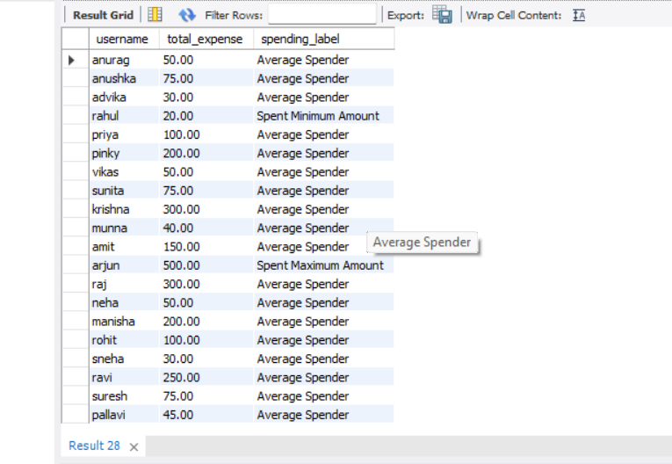
Write a query to find Users with the highest and lowest total expenses
SYNTAX:
SELECT u.username,SUM(e.amount) AS total_expense,CASE WHEN SUM(e.amount) = me.max_expense THEN 'Spent Maximum Amount' WHEN SUM(e.amount) = mi.min_expense THEN 'Spent Minimum Amount' ELSE 'Average Spender' END AS spending_label FROM users u JOIN expenses e ON u.user_id = e.user_id JOIN ( SELECT MAX(user_expense) AS max_expense FROM (SELECT SUM(amount) AS user_expense FROM expenses GROUP BY user_id) AS max_expense_subquery) me ON 1 = 1 JOIN ( SELECT MIN(user_expense) AS min_expense FROM (SELECT SUM(amount) AS user_expense FROM expenses GROUP BY user_id) AS min_expense_subquery) mi ON 1 = 1 GROUP BY u.username, me.max_expense, mi.min_expense;

Slide 26

Views
Create view using users details expenses
View for Budget Summary
Notes:
Notes to presenter:
What steps will you be taking as a result of this learning experience?
Did you learn from any failed experiences? How will you do things differently?
What advice will you give to others so they can learn from your experiences?
How can you share what you learned with a real-world audience?
Some examples of next steps might be:
After delivering my first persuasive presentation, I am thinking about joining the debate team.
After making my first film, I’m considering entering it in our school film festival or local film festival.
After connecting with this career expert, I’d like to do some research on that career field because it sounds interesting to me.
This SmartArt allows you add images and text to help outline your process. If a picture is worth a thousand words, then pictures and words should help you communicate this reflection on learning perfectly! You can always click on Insert>SmartArt to change this graphic or select the graphic and click on the Design contextual menu to change the colors.
Feel free to use more than one slide to share your next steps. It also helps to add some video content to explain your message.

Slide 27
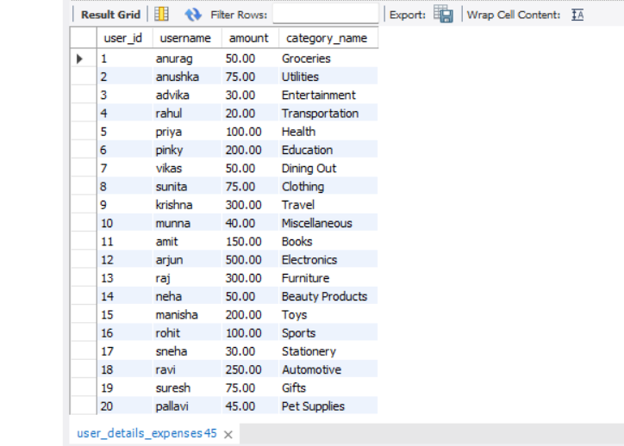
Create view using users details expenses
SYNTAX:
CREATE VIEW user_details_expenses AS SELECT users.user_id,users.username, expenses.amount, categories.category_name FROM users JOIN expenses ON users.user_id = expenses.user_id JOIN categories ON expenses.category_id = categories.category_id;

Slide 28
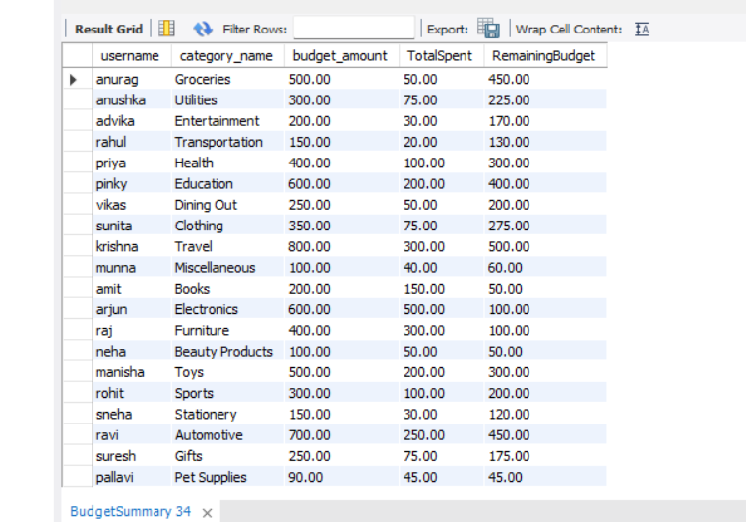
View for Budget Summary
SYNTAX:
CREATE VIEW BudgetSummary AS SELECT Users.username,Categories.category_name, Budgets.budget_amount, SUM(Expenses.amount) AS TotalSpent, (Budgets.budget_amount - SUM(Expenses.amount)) AS RemainingBudgetFROM Users INNER JOIN Budgets ON Users.user_id = Budgets.user_id INNER JOIN Expenses ON Users.user_id = Expenses.user_id AND Budgets.category_id = Expenses.category_id INNER JOIN Categories ON Budgets.category_id = Categories.category_id GROUP BY Users.username, Categories.category_name, Budgets.budget_amount;

Slide 29

PREPARED BY :
Anurag .v. Thakur
IT VEDANT
T331/DS&DA/NOV2024/PS
Data Science & Data Analytics

Slide 30


